Slide 1
Computer Networks
Prabhu Subramanian
prabhus@wilp.bits-pilani.ac.in

Slide 2

IMP Note to Self

Slide 3
Important Note to Students
It is important to know that just login to the session does not guarantee the attendance.
Once you join the session, continue till the end to consider you as present in the class.
IMPORTANTLY, you need to make the class more interactive by responding to Professors queries in the session.
Whenever Professor calls your number / name, you need to respond, otherwise it will be considered as ABSENT

Slide 4
SEWI ZC467 - COMPUTER NETWORKS
Lecture No. 06

Slide 5
CONTENTS
TCP: Segment structure, Setup, Termination, State transitions
TCP Flow Control
TCP Connection Management

Slide 6
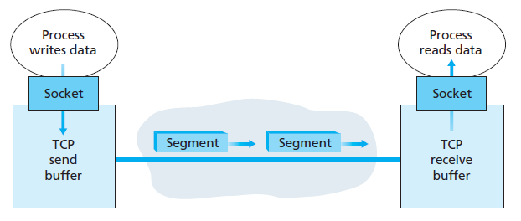
TCP: Overview RFCs: 793,1122,1323, 2018, 2581
TCP send and receive buffers
The maximum amount of data that can be grabbed and placed in a segment is limited by the maximum segment size (MSS).
The MSS is typically set by first determining the length of the largest link-layer frame that can be sent by the local sending host (the so-called maximumtransmission unit, MTU),

Slide 7
TCP: Overview RFCs: 793,1122,1323, 2018, 2581
point-to-point:
  one sender, one receiver
reliable, in-order byte steam:
  no “message boundaries”
pipelined:
  TCP congestion and flow control set window size
full duplex data:
  bi-directional data flow in same connection
  MSS: maximum segment size
connection-oriented:
  handshaking (exchange of control msgs) inits sender, receiver state before data exchange
flow controlled:
  sender will not overwhelm receiver

Slide 8
TCP segment structure
32 bits
source port #
dest port #
segment seq #: counting bytes of data into bytestream (not segments!)
ACK: seq # of next expected byte; A bit: this is an ACK
sequence number
acknowledgement number
length (of TCP header)
head
len
not
used
A
P
S
receive window
flow control: # bytes receiver willing to accept
C
E
U
R
F
Internet checksum
checksum
Urg data pointer
options (variable length)
C, E: congestion notification
TCP options
application
data
(variable length)
data sent by application into TCP socket
RST, SYN, FIN: connection management

Slide 9
TCP sequence numbers, ACKs
outgoing segment from sender
Sequence numbers:
  byte stream “number” of first byte in segment’s data
source port #
dest port #
sequence number
acknowledgement number
rwnd
checksum
urg pointer
window size
N
Acknowledgements:
  seq # of next byte expected from other side
  cumulative ACK
  sender sequence number space
sent
ACKed
sent, not-yet ACKed
(“in-flight”)
usable
but not
yet sent
not
usable
Q: how receiver handles out-of-order segments
  A: TCP spec doesn’t say, - up to implementor
outgoing segment from receiver
source port #
dest port #
sequence number
acknowledgement number
A
rwnd
checksum
urg pointer

Slide 10

TCP sequence numbers, ACKs
Host A
Host B
After the TCP connection is established but before any data is sent, the client is waiting for byte 79 and the server is waiting for byte 42.
User types‘C’
Seq=42, ACK=79, data = ‘C’
host ACKs receipt of‘C’, echoes back ‘C’
Seq=79, ACK=43, data = ‘C’
host ACKs receipt of echoed ‘C’
Seq=43, ACK=80
Piggybacked ACK
simple telnet scenario

Slide 11
TCP round trip time, timeout
Q: how to set TCP timeout value?
longer than RTT, but RTT varies!
too short: premature timeout, unnecessary retransmissions
too long: slow reaction to segment loss
Q: how to estimate RTT?
SampleRTT:measured time from segment transmission until ACK receipt
  ignore retransmissions
SampleRTT will vary, want estimated RTT “smoother”
  average several recent measurements, not just current SampleRTT

Slide 12
TCP round trip time, timeout
EstimatedRTT = (1- α)*EstimatedRTT + α*SampleRTT
exponential weighted moving average (EWMA)
influence of past sample decreases exponentially fast
typical value: α = 0.125 (1/8)
RTT: gaia.cs.umass.edu to fantasia.eurecom.fr
RTT (milliseconds)
sampleRTT
EstimatedRTT
EstimatedRTT = 0.875 • EstimatedRTT + 0.125 • SampleRTT
time (seconds)

Slide 13

TCP round trip time, timeout
timeout interval: EstimatedRTT plus “safety margin”
  large variation in EstimatedRTT: want a larger safety margin
TimeoutInterval = EstimatedRTT + 4*DevRTT
estimated RTT
“safety margin”
DevRTT: EWMA of SampleRTT deviation from EstimatedRTT:
DevRTT = (1-β)*DevRTT + β*|SampleRTT-EstimatedRTT|
(typically, β = 0.25)
Check out the online interactive exercises for more examples: http://gaia.cs.umass.edu/kurose_ross/interactive/

Slide 14
Q1
Suppose that the three measured SampleRTT values are 106 ms, 120 ms, and 140 ms, Compute the EstimatedRTT after each of these SampleRTT values is obtained, using a value of α = 0.125 and assuming that the value of EstimatedRTT was 100 ms just before the first of these three samples were obtained. Compute also the DevRTT after each sample is obtained, assuming a value of β = 0.25 and assuming the value of DevRTT was 5 ms just before the first of these three samples was obtained. Last, compute the TCP TimeoutInterval after each of these samples is obtained.

Slide 15
Q2
Consider the TCP procedure for estimating RTT. Suppose that α = 0.1. Let SampleRTT₁ be the most recent sample RTT, let SampleRTT₂ be the next most recent sample RTT, and so on.
For a given TCP connection, suppose four acknowledgments have been returned with corresponding sample RTTs: SampleRTT₄, SampleRTT₃, SampleRTT₂, and SampleRTT₁. Express EstimatedRTT in terms of the four sample RTTs.
Generalize your formula for n sample RTTs.
For the formula in part (b) let n approach infinity. Comment on why this averaging procedure is called an exponential moving average.

Slide 16
TCP reliable data transfer
TCP creates rdt service on top of IP’s unreliable service
  pipelined segments
  cumulative acks
  single retransmission timer
retransmissions triggered by:
  timeout events
  duplicate acks
let’s initially consider simplified TCP sender:
ignore duplicate acks
ignore flow control, congestion control

Slide 17
TCP Sender events (simplified)
event: data received from application
create segment with seq #
seq # is byte-stream number of first data byte in segment
start timer if not already running
  think of timer as for oldest unACKed segment
  expiration interval: TimeOutInterval
event: timeout
retransmit segment that caused timeout
restart timer
event: ACK received
if ACK acknowledges previously unACKed segments
  update what is known to be ACKed
  start timer if there are still unACKed segments

Slide 18
TCP Sender (simplified)
data received from application above create segment, seq. #: NextSeqNum
pass segment to IP (i.e., “send”) NextSeqNum = NextSeqNum + length(data) if (timer currently not running)
start timer
Λ
NextSeqNum = InitialSeqNum SendBase = InitialSeqNum
wait for event
timeout
retransmit not-yet-acked segment with smallest seq. #
start timer
ACK received, with ACK field value y
if (y > SendBase) { SendBase = y
/* SendBase–1: last cumulatively ACKed byte */ if (there are currently not-yet-acked segments)
start timer else stop timer
}

Slide 19
TCP: retransmission scenarios
Host A
Host B
Host A
Host B
SendBase=92
Seq=92, 8 bytes of data
Seq=92, 8 bytes of data
timeout
timeout
Seq=100, 20 bytes of data
ACK=100
X
ACK=100
ACK=120
Seq=92, 8 bytes of data
Seq=92, 8
bytes of data
SendBase=100
send cumulative
ACK for 120
SendBase=120
ACK=100
ACK=120
SendBase=120
lost ACK scenario
premature timeout

Slide 20
TCP: retransmission scenarios
Host A
Host B
Seq=92, 8 bytes of data
Seq=100, 20 bytes of data
ACK=100
The intervals grow exponentially after
each retransmission.
X
ACK=120
Seq=120, 15 bytes of data
cumulative ACK covers for earlier lost ACK

Slide 21
Fast Retransmit
If sender receives 3 ACKs for same data, it assumes that segment after ACKed data was lost:
  fast retransmit: resend segment before timer expires
time-out period often relatively long:
  long delay before resending lost packet
detect lost segments via duplicate ACKs.
  sender often sends many segments back-to-back
  if segment is lost, there will likely be many duplicate ACKs for that segment

Slide 22
TCP ACK generation [RFC 1122, RFC 2581]
event at receiver
arrival of in-order segment with expected seq #. All data up to expected seq # already ACKed
arrival of in-order segment with expected seq #. One other segment has ACK pending
arrival of out-of-order segment higher-than-expect seq. # .Gap detected
arrival of segment that partially or completely fills gap
TCP receiver action
delayed ACK. Wait up to 500ms
for next segment. If no next segment, send ACK
immediately send single cumulative ACK, ACKing both in-order segments
immediately send duplicate ACK, indicating seq. # of next expected byte
immediate send ACK, provided that segment starts at lower end of gap

Slide 23

TCP fast retransmit
Host A
Host B
TCP fast retransmit
if sender receives 3 additional ACKs for same data (“triple duplicate ACKs”), resend unACKed segment with smallest seq #
  likely that unACKed segment lost, so don’t wait for timeout
Seq=92, 8 bytes of data
Seq=100, 20 bytes of data
Seq=120, 15 bytes of data
X
Seq=135, 6 bytes of data
Seq=141, 16 bytes of data
ACK=100
timeout
ACK=100
ACK=100
Receipt of three duplicate ACKs indicates 3 segments received after a missing segment – lost segment is likely. So retransmit!
ACK=100
Seq=100, 20 bytes of data

Slide 24
TCP Flow Control
flow control
sender won’t overflow
receiver’s buffer by
transmitting too much,
too fast
receive side of TCP connection has a receive buffer:
(currently)
unused buffer
space
speed-matching service: matching send rate to receiving application’s drain rate
IP
datagrams
TCP data
(in buffer)
application
process
app process may be slow at reading from buffer
Because TCP is not permitted to overflow the allocated buffer, we must have
LastByteRcvd – LastByteRead ≤ RcvBuffer

Slide 25
TCP Flow control: how it works
(currently)
unused buffer
space
receiver: advertises unused buffer space by including rwnd value in segment header
sender: limits # of unACKed bytes to rwnd
  guarantees receiver’s buffer doesn’t overflow
IP
datagrams
TCP data
(in buffer)
application
process
rwnd
RcvBuffer
(suppose TCP receiver discards out-of-order segments)
unused buffer space:
= rwnd (receive window)
= RcvBuffer-[LastByteRcvd - LastByteRead]
LastByteSent – LastByteAcked ≤ rwnd

Slide 26
TCP flow control
application
process
Q: What happens if network layer delivers data faster than application layer removes data from socket buffers?
Application removing data from TCP socket buffers
TCP socket
receiver buffers
TCP
code
Network layer delivering IP datagram payload into TCP socket buffers
IP
code
from sender
receiver protocol stack

Slide 27


TCP flow control
application
process
Q: What happens if network layer delivers data faster than application layer removes data from socket buffers?
Application removing data from TCP socket buffers
TCP socket
receiver buffers
TCP
code
Network layer delivering IP datagram payload into TCP socket buffers
IP
code
from sender
receiver protocol stack

Slide 28
TCP flow control
application
process
Q: What happens if network layer delivers data faster than application layer removes data from socket buffers?
Application removing data from TCP socket buffers
TCP socket
receiver buffers
TCP
code
receive window
flow control: # bytes receiver willing to accept
IP
code
from sender
receiver protocol stack

Slide 29
TCP flow control
application
process
Q: What happens if network layer delivers data faster than application layer removes data from socket buffers?
Application removing data from TCP socket buffers
TCP socket
receiver buffers
TCP
code
flow control
receiver controls sender, so sender won’t overflow receiver’s buffer by transmitting too much, too fast
IP
code
from sender
receiver protocol stack

Slide 30
TCP flow control
TCP receiver “advertises” free buffer space in rwnd field in TCP header
  RcvBuffer size set via socket options (typical default is 4096 bytes)
  many operating systems autoadjust RcvBuffer
sender limits amount of unACKed (“in-flight”) data to received rwnd
guarantees receive buffer will not overflow
to application process
RcvBuffer
buffered data
rwnd
free buffer space
TCP segment payloads
TCP receiver-side buffering

Slide 31
TCP flow control
flow control: # bytes receiver willing to accept
TCP receiver “advertises” free buffer space in rwnd field in TCP header
  RcvBuffer size set via socket options (typical default is 4096 bytes)
  many operating systems autoadjust RcvBuffer
sender limits amount of unACKed (“in-flight”) data to received rwnd
guarantees receive buffer will not overflow
receive window
TCP segment format

Slide 32
TCP connection management
before exchanging data, sender/receiver “handshake”:
agree to establish connection (each knowing the other willing to establish connection)
agree on connection parameters (e.g., starting seq #s)
application
application
connection state: ESTAB
connection variables:
  seq # client-to-server
  server-to-client
  rcvBuffer size
  at server,client
connection state: ESTAB
connection Variables:
  seq # client-to-server
  server-to-client
  rcvBuffer size
  at server,client
network
network
Socket clientSocket =
newSocket("hostname","port number");
Socket connectionSocket = welcomeSocket.accept();

Slide 33


Agreeing to establish a connection
2-way handshake:
Q: will 2-way handshake always work in network?
variable delays
retransmitted messages (e.g. req_conn(x)) due to message loss
message reordering
can’t “see” other side
Let’s talk
ESTAB
OK
ESTAB
choose x
req_conn(x)
ESTAB
acc_conn(x)
ESTAB

Slide 34

2-way handshake scenarios
choose x
req_conn(x)
ESTAB
acc_conn(x)
ESTAB
data(x+1)
accept
data(x+1)
ACK(x+1)
connection
x completes
No problem!

Slide 35

2-way handshake scenarios
choose x
req_conn(x)
ESTAB
retransmit
req_conn(x)
acc_conn(x)
ESTAB
req_conn(x)
connection
x completes
client terminates
server
forgets x
ESTAB
acc_conn(x)
Problem: half open connection! (no client)

Slide 36
2-way handshake scenarios
choose x
req_conn(x)
ESTAB
retransmit
req_conn(x)
acc_conn(x)
ESTAB
data(x+1)
accept
data(x+1)
retransmit
data(x+1)
connection
x completes
client terminates
server
forgets x
req_conn(x)
ESTAB
data(x+1)
accept
data(x+1)
Problem: dup data accepted!

Slide 37
TCP 3-way handshake
Server state
Client state
serverSocket = socket(AF_INET,SOCK_STREAM)
serverSocket.bind((‘’,serverPort))
serverSocket.listen(1)
connectionSocket, addr = serverSocket.accept()
clientSocket = socket(AF_INET, SOCK_STREAM)
LISTEN
clientSocket.connect((serverName,serverPort))
LISTEN
choose init seq num, x
send TCP SYN msg
SYNSENT
SYNbit=1, Seq=x
choose init seq num, y
send TCP SYNACK
msg, acking SYN
SYN RCVD
SYNbit=1, Seq=y
ACKbit=1; ACKnum=x+1
received SYNACK(x)
indicates server is live;
send ACK for SYNACK;
this segment may contain
client-to-server data
ESTAB
ACKbit=1, ACKnum=y+1
received ACK(y)
indicates client is live
ESTAB

Slide 38
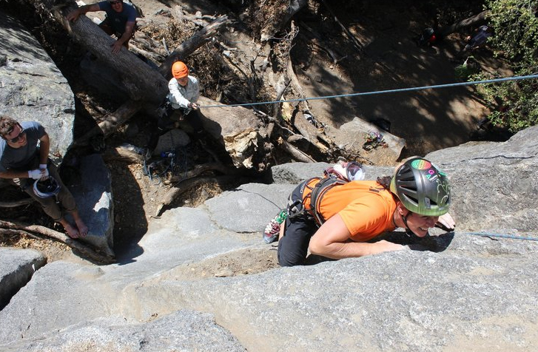
TCP 3-way handshake
1. On belay?
2. Belay on.
3. Climbing.

Slide 39
Closing a TCP connection
client, server each close their side of connection
  send TCP segment with FIN bit = 1
respond to received FIN with ACK
  on receiving FIN, ACK can be combined with own FIN
simultaneous FIN exchanges can be handled

Slide 40
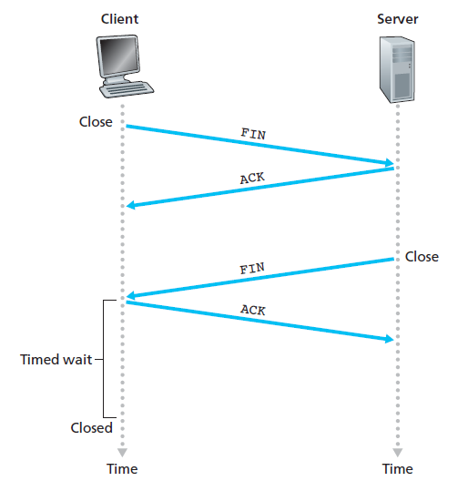



TCP: closing a connection
client state
ESTAB
server state
ESTAB
clientSocket.close()
FIN_WAIT_1
can no longer send but can receive data
FINbit=1, seq=x
CLOSE_WAIT
ACKbit=1; ACKnum=x+1
can still send data
FIN_WAIT_2
wait for server
close
LAST_ACK
FINbit=1, seq=y
TIMED_WAIT
can no longer send data
ACKbit=1; ACKnum=y+1
timed wait for 2*max segment lifetime
CLOSED
CLOSED

Slide 41
Thank You!

Slide 42
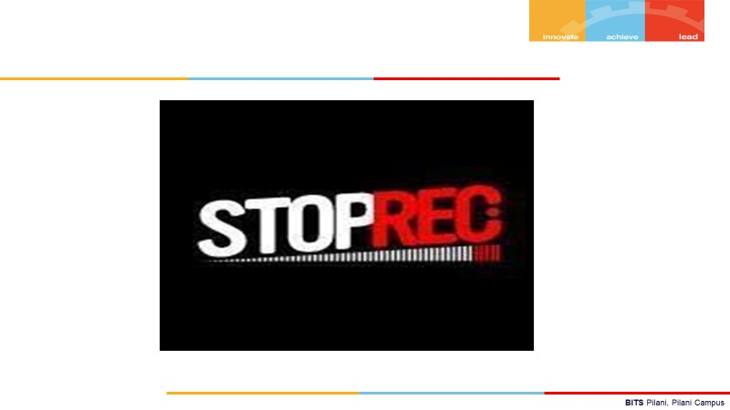
END the session before leaving

